Slide 1
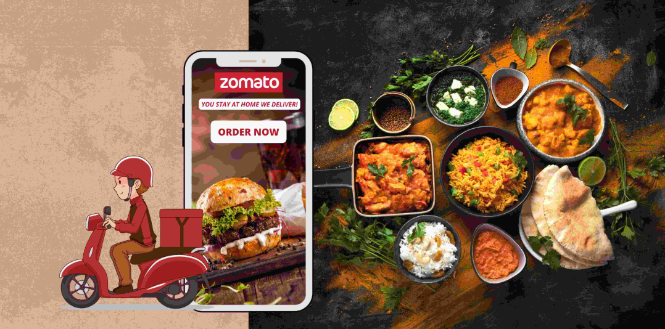
NEW RESTAURANT LOCATION SUGGESTION
SATYAM KUMAR MISHRA
03/02/2025

Slide 2
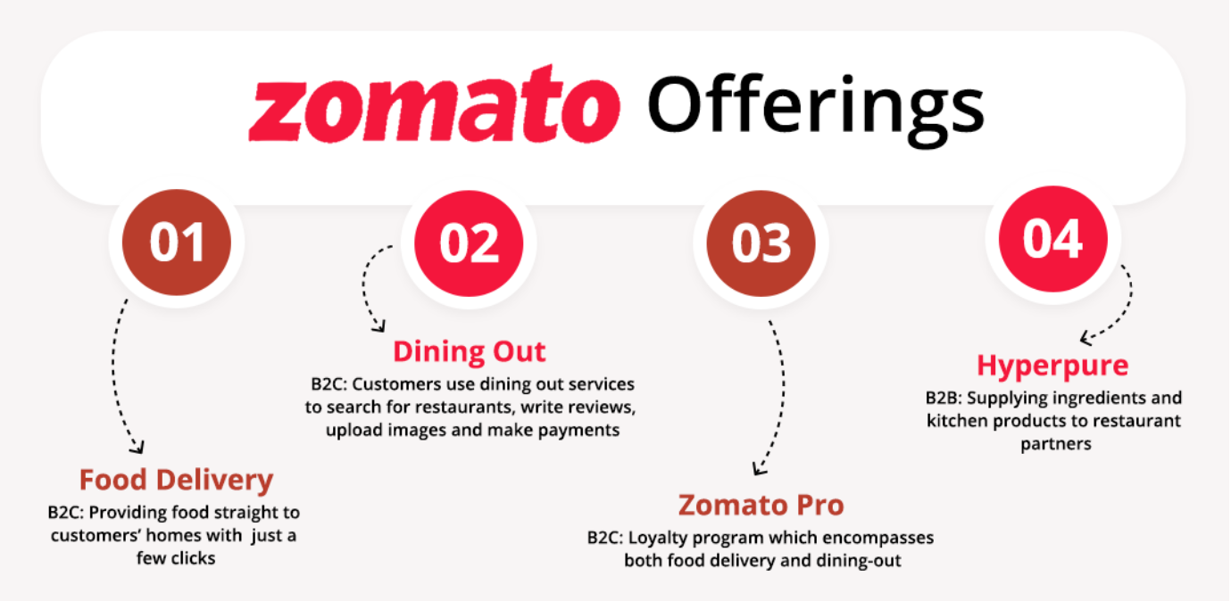
Introduction and objectives
This project focuses on analyzing restaurant data to identify key insights for Zomato's expansion strategy. The objective of evaluating competition, customer ratings, pricing trends, and economic viability across multiple countries is to determine the best locations for opening new restaurants. Key analyses include identifying low-competition markets, assessing customer satisfaction, studying price sensitivity, and evaluating the impact of online services on ratings.

Slide 3
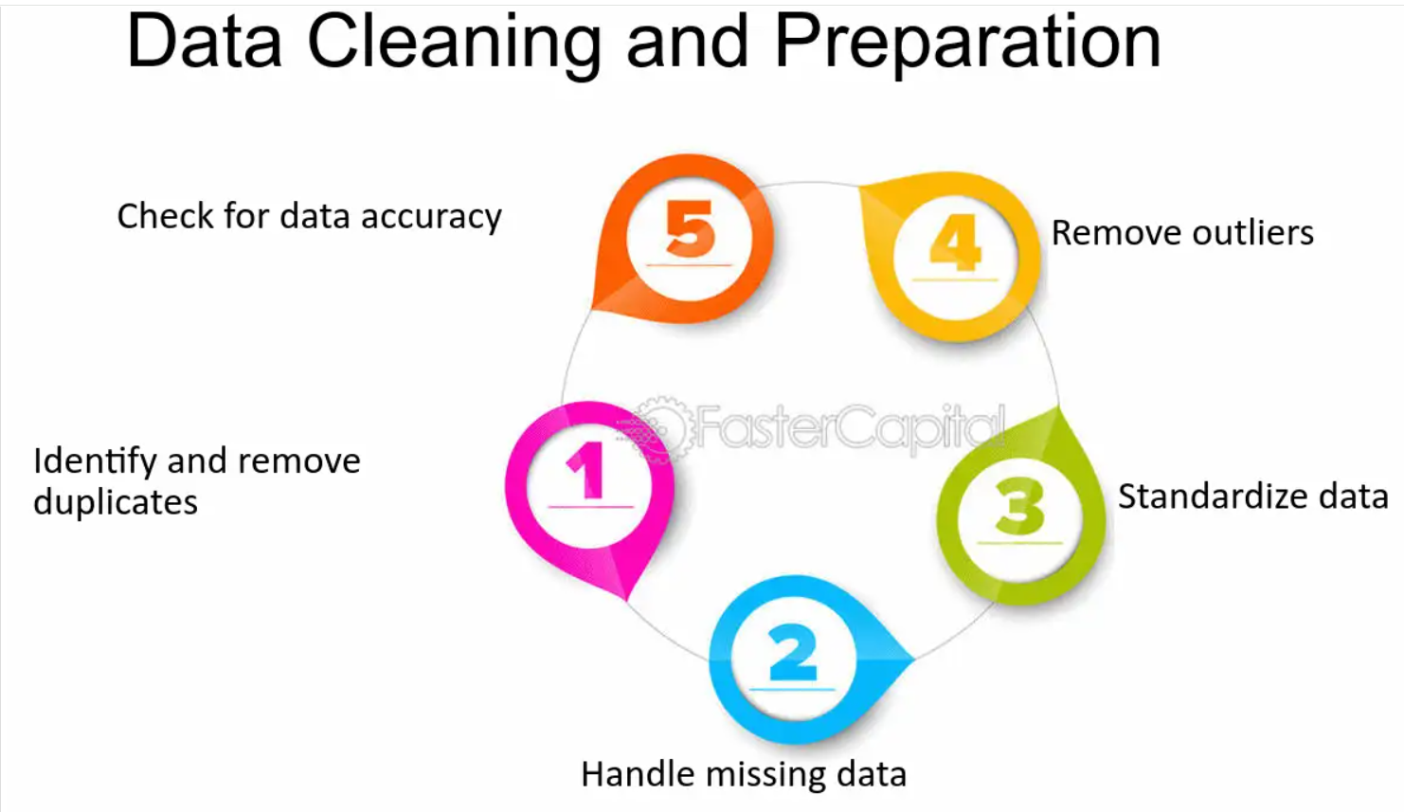
DATA OVERVIEW
Removed Duplicates: Identified and removed all duplicate records to ensure data integrity.
Handled Missing Values: Imputed or removed null entries to maintain dataset consistency.
Data Type Standardization: Converted date columns to datetime format and ensured numerical fields were properly typed.
General Cleaning: Trimmed whitespace, corrected typos in categorical fields, and ensured uniform formatting throughout the dataset.

Slide 4


Methodology
Data Cleaning: Utilized functions like TRIM, CLEAN, and Remove Duplicates to ensure data accuracy.
Data Enrichment: Enhanced the dataset with additional variables using VLOOKUP to cross-reference external data sources
Descriptive Analysis: Employed PivotTables for summarizing key metrics and identifying sales patterns across different regions and product categories.
Trend Analysis: Conducted time series analysis using TREND functions to predict future sales growth.
Customer Segmentation: Applied SORT and FILTER functions to classify customers based on purchasing behavior and demographics.
Visualization: Created dynamic charts and dashboards for data representation, enabling interactive data exploration.

Slide 5
This graph represents the number of restaurants in each country and provides insights for selecting a location to open a new restaurant. It highlights India as the most saturated market, while countries like Canada, Indonesia, Qatar, Philippines, Turkey, Sri Lanka, and Singapore etc have fewer restaurants, indicating potential opportunities.

Slide 6
NO. OF RESTAURANT OPEN EACH YEAR
1120
1100
1080
1060
1040
Total
1020
1000
980
2010
2011
2012
2013
2014
2015
2016
2017
2018
Peak years: 2011 and 2018 saw the highest number of restaurant openings.
Dip: There was a noticeable drop in new openings during 2012 and 2015.
Recovery & Growth: The years 2016 to 2018 show a steady upward trend, indicating recovery and expansion in the restaurant opening.

Slide 7
Highest Dining Costs: The United States, United Kingdom, and Singapore are the most expensive countries for dining out, each with an average cost above ₹40,000.
Medium Dining Costs: Australia, Canada, and New Zealand fall in the mid-range bracket, costing between ₹25,000–₹45,000 on average.
Low Dining Costs: India, Indonesia, Sri Lanka, and Philippines offer the lowest average cost for two, making them attractive for budget-conscious consumers.

Slide 8
Majority of customers spend in the lowest price range(1), showing a strong preference for affordable dining.
Mid-range spending(2 & 3) also sees traction, indicating moderate budget flexibility among a significant segment.
Only few customers fall in the high spending bracket(4), highlighting a small premium customer base.

Slide 9
88% of Restaurants do not offer table booking, only 12% provide this feature
The table booking feature has positive impacts on average ratings, and very few restaurants have implemented this feature.
So, according to data, adopting table booking, potentially improve customer satisfaction and boost their ratings.
74% of restaurants do not offer online delivery
Only 26% have adopted this service
The online delivery feature has positive impacts on average ratings, and very few restaurants have implemented this feature
So, according to data, adopting online delivery improves customer satisfaction and boosting their ratings.

Slide 10
North Indian is the most popular cuisine a safe bet, but expect high competition, so differentiation is key.
Chinese and Fast Food show solid demand with moderate competition, making them good mid-risk options.
Bakery, Desserts, Street Food and Cafe-style show low competition.
So In my opinion, North Indian and Chinese cuisines are quite common, so we will include them in our new restaurant as well, along with some popular street food from the country where we are opening the restaurant.

Slide 11
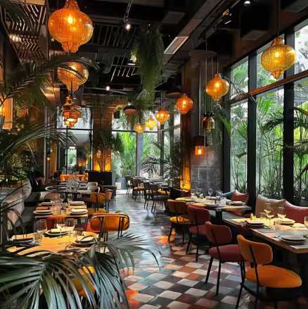
Country | City | Average of Average_Cost_for_two_person_in _INR | Average of Rating
Indonesia | Bandung | 2.65 | 4.20
Indonesia | Bogor | 2.65 | 3.85
Qatar | Doha | 11870 | 4.06
Indonesia | Jakarta | 2.65 | 4.36
Philippines | Makati City | 3110 | 4.65
Philippines | Mandaluyong City | 3110 | 4.63
Philippines | Pasay City | 3110 | 4.37
Philippines | Pasig City | 3110 | 4.63
Philippines | Quezon City | 3110 | 4.80
Philippines | San Juan City | 3110 | 4.25
Philippines | Santa Rosa | 3110 | 3.80
Philippines | Tagaytay City | 3110 | 4.50
Philippines | Taguig City | 3110 | 4.53
Indonesia | Tangerang | 2.65 | 4.30
SUGGEST COUNTRIES FOR NEW RESTAURANTS
Indonesia (21 restaurants, 4.30 rating)
Philippines (22 restaurants, 4.47 rating)
Qatar (20 restaurants, 4.06 rating)
Philippines (High rating, good spending power)
Indonesia (High rating, low cost)
Qatar (High GDP per capita, good rating)

Slide 12

Strategic Recommendations
Expand in High-Potential Cities: Focus on Quezon City, Makati, Tangerang, and Doha, where competition is low and customer ratings are high.
Adapt Pricing to Market Sensitivity: Maintain affordable pricing in Indonesia, balanced rates in the Philippines, and premium pricing in Qatar with high-quality service.
Offer Trending & Local Cuisines: Combine local specialties with global favorites (e.g., Japanese, Mediterranean) and include vegan or gluten-free options to attract diverse customers.
Enable Online Delivery & Table Booking: Improve customer convenience and satisfaction by offering seamless ordering and reservation options.
Focus on Quality & Experience: Prioritize consistency in food, service, and ambiance to drive positive ratings and customer loyalty

Slide 13
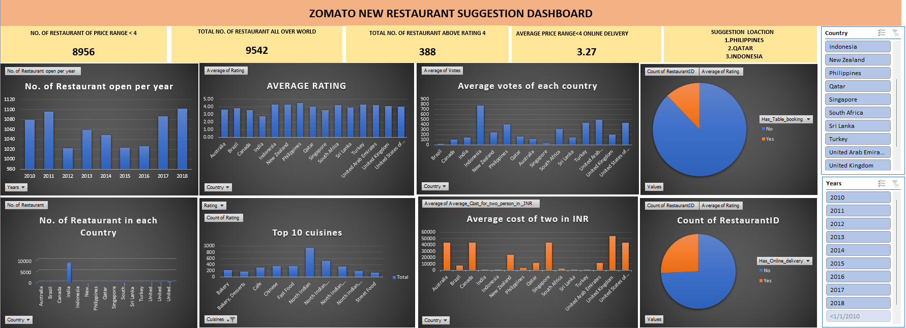

Slide 14
Low-Competition Markets: Focused on countries and cities with fewer existing restaurants to reduce direct competition.
Target Examples: Indonesia (Jakarta, Tangerang) and Qatar (Doha) offer less saturated markets compared to the USA or UK.
High Customer Ratings: Prioritized cities with average ratings above 4.0, reflecting strong local food culture and customer satisfaction.
Top-Rated Cities: Quezon City (4.80) and Makati City (4.65) in the Philippines show exceptional customer approval.
Economic Viability: GDP per capita was used to evaluate purchasing power and affordability in each country.
Premium Potential: Qatar’s high GDP per capita supports upscale dining experiences.
Affordable Dining Strength: Indonesia, with a lower GDP, shows high ratings despite low prices, indicating value-driven markets.
Price Sensitivity Insight: Analysis shows that customers in Indonesia prefer affordable meals, making pricing a key success factor.
Data-Driven City Selection: Cities were filtered using competition level, rating score, and economic indicators.
Final Recommended Cities:
Philippines: Quezon City, Makati City, Pasig City, Taguig City
Indonesia: Jakarta, Tangerang
Qatar: Doha

Slide 15

CONCLUSION
The analysis highlights a clear opportunity for restaurant expansion in select cities across the Philippines, Indonesia, and Qatar. By targeting low-competition markets with high customer satisfaction and favorable economic conditions, businesses can maximize their chances of success.
The Philippines offers top-rated cities with strong food culture and consistent demand.
Indonesia presents an ideal landscape for affordable dining concepts with proven customer satisfaction.
Qatar provides potential for premium restaurant experiences backed by high spending capacity.
By aligning expansion strategies with these insights, companies can enter markets that are both ripe for growth and tailored to local consumer preferences.

